Slide 1
CS 4032 – Web Programming
Dr. Hassan Sartaj

Slide 2
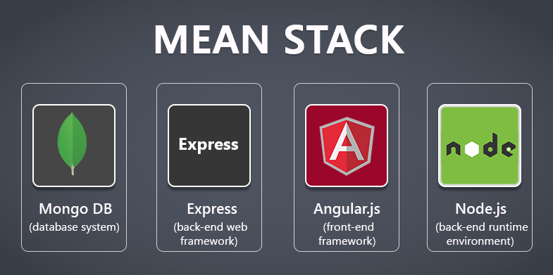
Collection of JavaScript based technologies used to develop web applications.

Slide 3
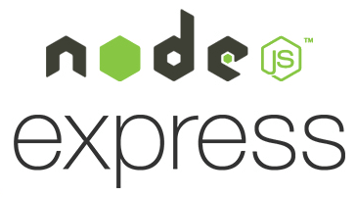

Slide 4
What is node.js ?
An open-source server environment
Uses JavaScript on the server
Node.js is free
Node.js runs on various platforms (Windows, Linux, Unix, Mac OS X, etc.)
Runs on Google's V8 JavaScript Engine
Support Asynchronous Programming

Slide 5
Synchronous Programming
Some tasks may take a very long time, e.g., read/write a file on disk, request data from a server, query a database …
Why waiting is bad??
some_task(); /*
wait for task to
complete
*/
// process the result
// of task
… …
// do other things
… …

Slide 6
Multi-processing and Multi-threading
One process/thread
Another process/thread
some_task();
// process the result
// of task
… …
// do other things
… …
What's the different between a process and a thread??

Slide 7
Problems of Multi-processing and Multi-threading
OS must allocate some resources for each process/thread
Switching between processes and threads (a.k.a. context switch) takes time
Communicating among processes and synchronizing multiple threads are difficult
Big problems for busy web servers
One of the reasons why Node.js became popular in server-side development

Slide 8
Asynchronous Programming
Example : Web server
Open a file on the server and return the content to the client
PHP, ASP, Others
Node
Sends the task to the computer's file system.
Waits while the file system opens and reads the file.
Returns the content to the client.
Ready to handle the next request
Sends the task to the computer's file system.
Ready to handle the next request.
When the file system has opened and read the file, the server returns the content to the client.

Slide 9
Asynchronous Programming …
callback(result) {
// process the result
// of task
… …
}
some_task( callback ); /*
calls to some_task()
returns immediately
*/
// do other things
… …

Slide 10
… Asynchronous Programming
Everything runs in one thread
Asynchronous calls return immediately (a.k.a. non-blocking)
A callback function is called when the result is ready
A.K.A. Event-driven Programming
A callback function is basically an event handler that handles the "result is ready" event
func(args…, callback(err,result))

Slide 11
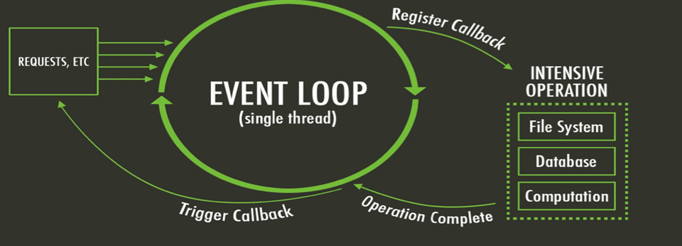
What is unique about Node.js?
JavaScript on server-side thus making communication between client and server will happen in same language
Servers normally thread based but Node.JS is “Event” based. Node.JS serves each request in a Evented loop that can handle simultaneous requests.
Notes:
Thread based servers like Apache server will serve each web request as individual threads which doesn’t fit well for concurrent connections.

Slide 12
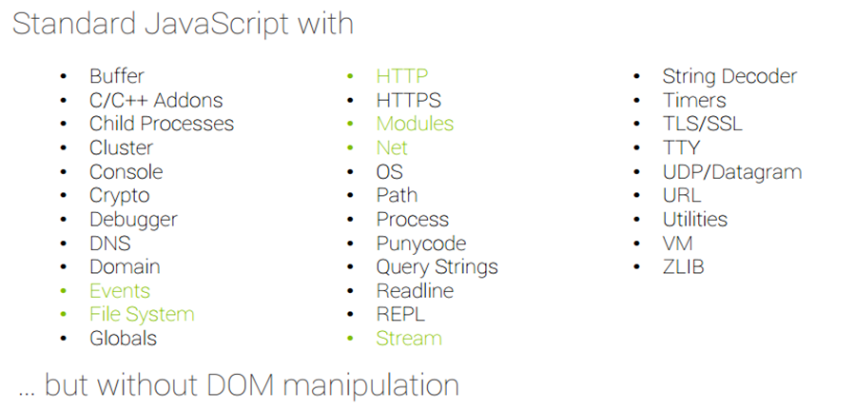
Why Use Node.js ?
Node's goal is to provide an easy way to build scalable network programs.
It lets you layered on top of the TCP library is an HTTP and HTTPS client/server.
The JS executed by the V8 JavaScript engine (the thing that makes Google Chrome so fast)
Node provides a JavaScript API to access the network and file system.

Slide 13
What can’t do with Node?
Node is a platform for writing JavaScript applications outside web browsers. This is not the JavaScript we are familiar with in web browsers. There is no DOM built into Node, nor any other browser capability.
Node can’t run on GUI, but run on terminal
In the Node.js module system, each file is treated as a separate module.

Slide 14
Installing and using node Module
Install a module…..inside your project directory
npm install <module name>
Using module….. Inside your JavaScript code
var http = require(‘http’);
var fs = require(‘fs’);
var express = require(‘express’);

Slide 15
Hello World example (index.js)
const http = require('http’);
const hostname = '127.0.0.1’;
const port = 3000;
const server = http.createServer((req, res) => {
res.statusCode = 200;
res.setHeader('Content-Type', 'text/plain’);
res.end('Hello World'); });
server.listen(port, hostname, () => {
console.log(`Server running at http://${hostname}:${port}/`);
});

Slide 16

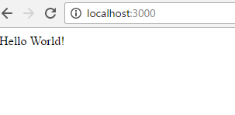
Run your hello world application
Run the app with the following command:
node index.js
Then, load http://localhost:3000/ in a browser to see the output.

Slide 17
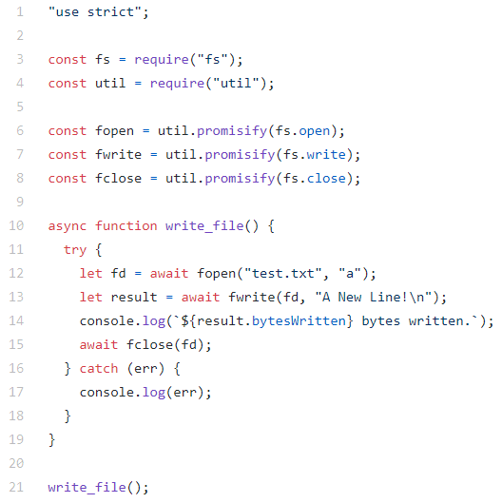
Asynchronous Programming Example
write_file.js: open a file, add one line, then close the file
Use of the File System package
open()
write()
close()
"Callback Hell" (a.k.a. "Pyramid of Doom")
async declares a function to be asynchronous
The return value of the function will be wrapped inside a Promise
await waits until a Promise settles and returns its result
await can only be used in an async function

Slide 18
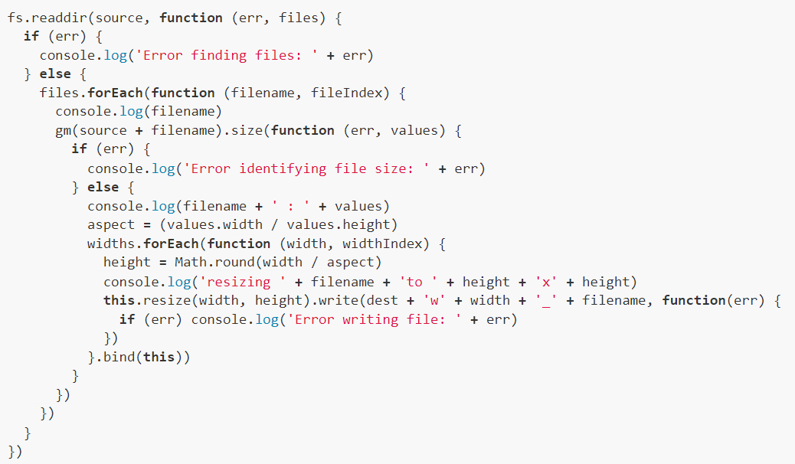
Callback Hell Example

Slide 19
Promise
A Promise is a JavaScript object
executor: a function that may take some time to complete. After it's finished, it sets the values of state and result based on whether the operation is successful
state: "pending" ➔ "fulfilled"/"rejected"
result: undefined ➔ value/error
var promise = doSomethingAync()
promise.then(onFulfilled, onRejected)

Slide 20
Use A Promise
promise.then(
function(result) {/* handle result */},
function(err) {/* handle error */ }
);
After executor finishes, either the success handler or the error handler will be called and result will be passed as the argument to the handler

Slide 21
About Promise
There can only be one result or an error
Once a promise is settled, the result (or error) never changes
then() can be called multiple times to register multiple handlers

Slide 22
Other Common Usage of Promise
promise.then( success_handler );
promise.then( null, error_handler );
promise.catch( error_handler );
promise
.then( success_handler )
.catch( error_handler )

Slide 23
Promise Example
get_page_promise.js: request and print a web page
Use of the request-promise-native package
request() returns a promise
const request2 = require("request-promise-native");
function get_page_with_promise() {
request2("http://nu.edu.pk").then(body => console.log(body));
}

Slide 24
Promises Chaining
Suppose we have three functions f1, f2, f3
f1 returns a Promise
f2 relies on the result produced by f1
f3 relies on the result produced by f2
f1.then(f2).then(f3)

Slide 25
Understand Promise Chaining …
f1.then(f2)
then() returns a Promise based on the return value of the handler function
If f2 return a regular value, the value becomes the result of the Promise
If f2 return a promise, the result of that Promise becomes the result of the Promise returned by then()

Slide 26
… Understand Promising Chaining
f1.then(f2).then(f3)
The result of f1 is passed to f2
The result of f2 is passed to f3

Slide 27
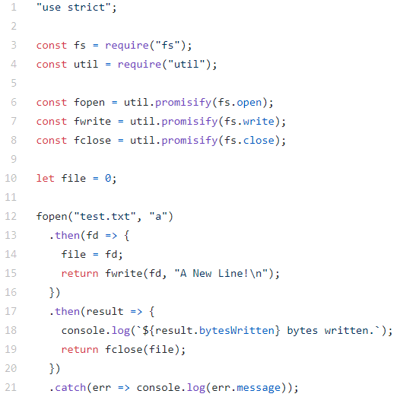
Promise Example 2
write_file_promise.js: open a file, add one line, then close the file
Use of promisify() in the Utilities package
Original function:
func(args…, callback(err,result))
Promisified:
func(args…) returns a Promise

Slide 28
Parallel Execution
Promise.all([promise1, promise2 …]).then(
function(results) {
// results is an array of values, one
// by each promise
}
)
Promise.race([promise1, promise2 …]).then(
function(result) {
// result is the result of the promise
// that settles first
}
)

Slide 29
Running Node.js Server Applications
Run server applications using nodemon during development
Automatically restart the application when changes in the project are detected
Deploy server applications using pm2
Run server applications as managed background processes

Slide 30
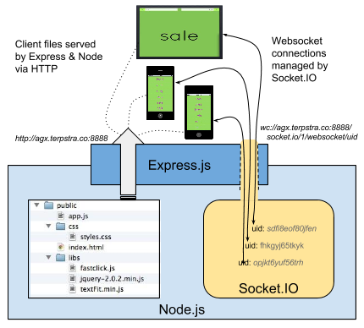
Express
Minimal and flexible Node.js web application framework that provides a robust set of features for web and mobile applications.

Slide 31
Express gives ease of functionality
Routing
Delivery of Static Files
“Middleware” – some ease in development (functionality)
Form Processing
Simple forms of Authentication
View support
Basic error handling, e.g. rejecting malformed requests
A lot of this you can do in NodeJS but, you may write more code to do it than if you use the framework Express.
There are other alternatives than Express (the E in MEAN) like Sail, Meteor

Slide 32
Express Basics
Application
Routing
Handling requests
Generating response
Middleware
Error handling

Slide 33
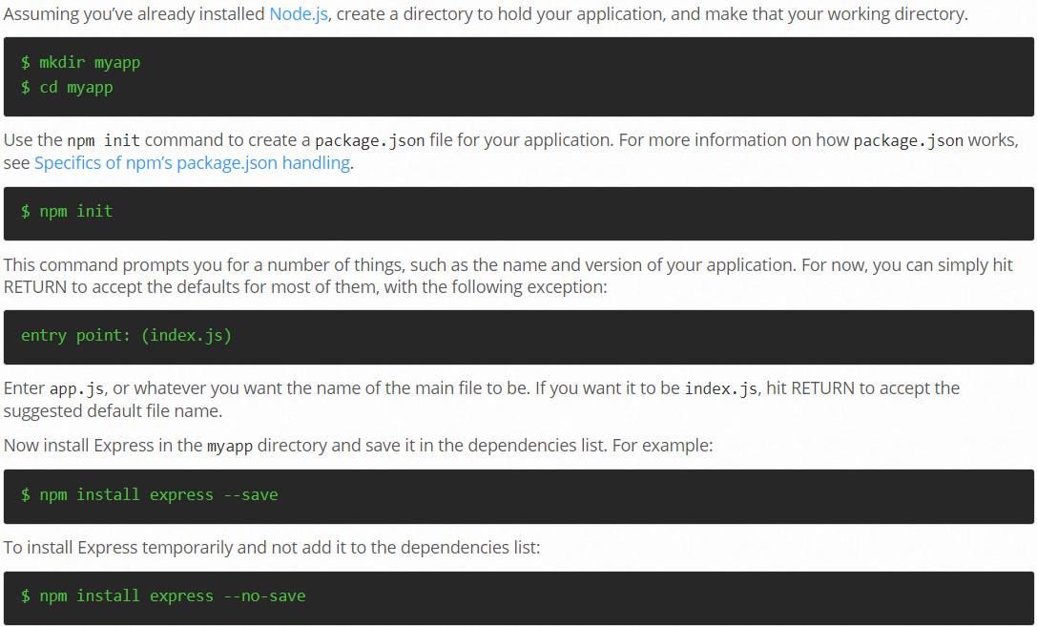
Express Installation

Slide 34
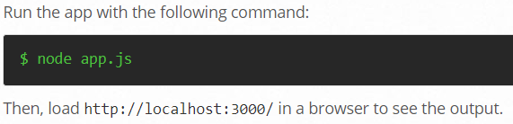
HelloWorld in Express
const express = require('express');
const app = express();
app.get('/', (req, res) =>
res.send('Hello World!'));
app.listen(3000, () =>
console.log('Listening on port 3000'));

Slide 35
Application
const app = express();
The Application object
Routing requests
Rendering views
Configuring middleware

Slide 36
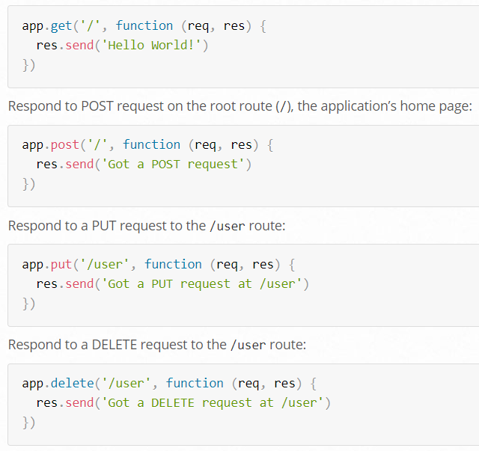
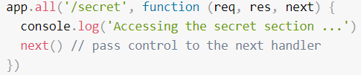
Routing Methods in App
app.all( path, callback [,callback …])
app.METHOD( path, callback, [,callback …])
METHOD is one of the routing methods, e.g. get, post, and so on
Notes:
The following callback is executed for requests to /secret whether using GET, POST, PUT, DELETE, or any other HTTP request method:

Slide 37
Modularize Endpoints Using Express Router …
Example
List users: /users/, GET
Add user: /users/, POST
Get user: /users/:id, GET
Delete user: /users/:id, DELETE

Slide 38
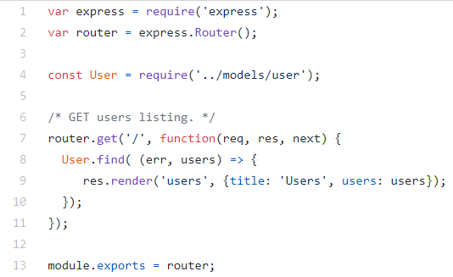
… Modularize Endpoints Using Express Router
const router = express.Router();
router.get('/', …);
router.post('/', …);
… …
module.exports = router;
users.js
A router is like a "mini app"

Slide 39
… Modularize Endpoints Using Express Router
const users = require('./users');
app.use('/users', users);
Attach the router to the main app at the URL
app.js
app.use('/', indexController);
app.use('/users', usersController);
app.use('/api/login', loginRestController);

Slide 40
Handling Requests
Request
Properties for basic request information such as URL, method, cookies
Get header: get()
User input
Request parameters: req.query
Route parameters: req.params
Form data: req.body
JSON data: req.body

Slide 41


Example: Add
GET: /add?a=10&b=20
GET: /add/a/10/b/20
POST (Form): /add
Body: a=10&b=20
POST (JSON): /add
Content-Type: application/json
Body: {"a": 10, "b": 20}

Slide 42
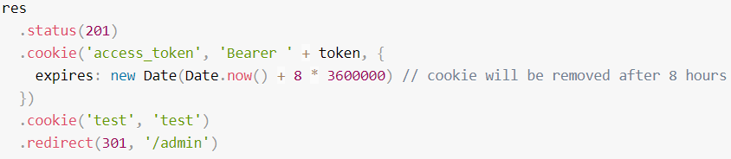

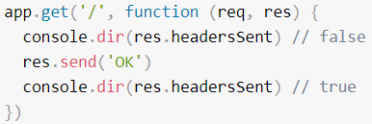

Generating Response
Response
Set status: status()
end()
Send JSON: json()
Send other data: send()
Redirect: redirect()
Other methods for set headers, cookies, download files etc.

Slide 43
Middleware
Middleware
request
request
response
… …
response
Express Application
A middleware is a function that has access to three arguments: the request object, the response object, and a next function that passes control to the next middleware function

Slide 44
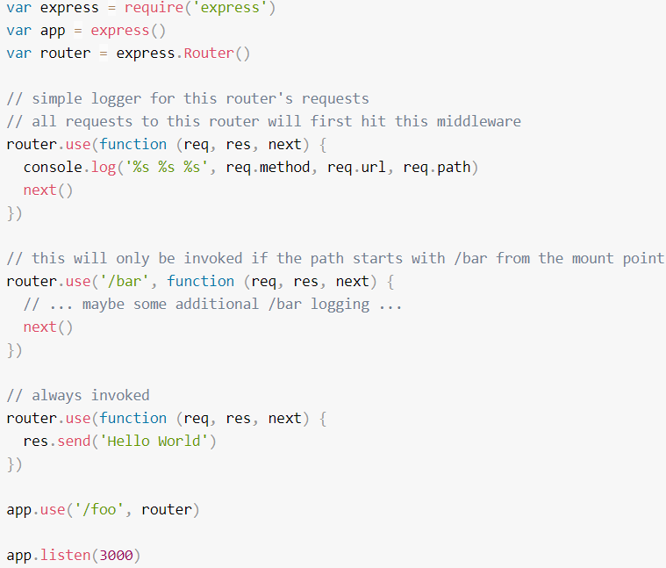
Middleware Example
Create a simple request logger middleware that prints out request URL, method, and time
The next argument
Add the middleware to the application using app.use()
Middleware can also be added at the router level with router.use()

Slide 45
Other Middlewares
express.json() parses JSON request body and add JSON object properties to req.body
express.urlencoded() parses urlencoded request body and request parameters to req.body
Route handler functions are also middleware
Where is next??
Remember to use next if you have more than one handler functions for a route
Middleware order is important!

Slide 46
Error Handling Middleware
Error handling middleware has an extra argument err, e.g. (err, req, res, next)
Calling next(err) will bypass the rest of the regular middleware and pass control to the next error handling middleware
err is an Error object
Express adds a default error handling middleware at the end of the middleware chain

Slide 47
Error Handling Example
Create a middleware that handles API errors, i.e. returns JSON instead of an error page
// error handler
app.use(function(err, req, res, next) {
res.status(err.status || 500);
if (req.originalUrl.startsWith('/api/')) {
res.json({ msg: err.message });
} else {
res.locals.message = err.message;
res.locals.error = req.app.get('env') === 'development' ? err : {};
res.render('error');
}
});

Slide 48
Readings
Express Documentation

Slide 49
Thank you!

